Slide 1
Gaussian beam wavefront correction
Anders Pedersen
02.02.2018

Slide 2
Phase curvature vs. displacement

Slide 3
Beam waist vs. diplacement

Slide 4
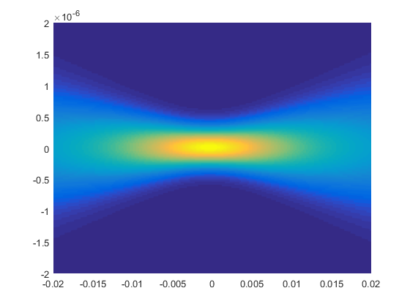
Intensity map

Slide 5
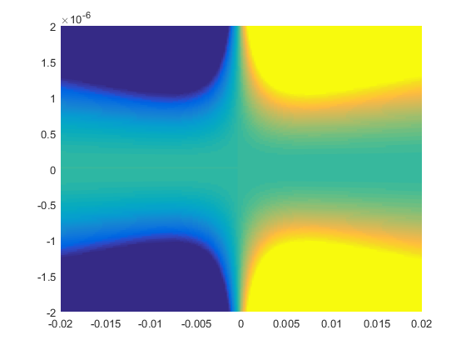
Phase map

Slide 6
Fitting values
Wavefront displacement from RTM d2
Optimization algorithm = phase front fit = beam waist fit = 0.46 mm
Central beam waist: w₀
Phase front fit = beam waist fit = 416 nm

